Slide 1
InnoFood
Team 3

Slide 2
InnoFood
It's a food delivery order service , where you order food from canteen trough innoFood website
And it will be delivered to you.

Slide 3
Goals
Deliver food for clients when they order it
Provide a fast service
Provide a high quality food

Slide 4
Use case quality-
Rate Criteria -
Correctness
Related to the product
Importantancy
Maintainability

Slide 5
Use case quality-
Code quality
Code readability
Code style
Code Standards

Slide 6
Recorded videos MVP and Test Cases

Slide 7
Interview Script
Relevance
Questions that being conducted
The value of the questions
Quality in all 7/10

Slide 8
Use cases - Admin
Create Cafe
Delete Cafe
Edit Cafe
Create Manager
Edit manager
Delete Manger
Quality in all 8/10
Code quilty 9/10

Slide 9
Use cases - Manger
Confirm order
Decline order
Create dish
Edit menu
Resolve complaint
Quality 9/10
Code Quality 8/10

Slide 10
Use cases - Customer
Create order
Delete order
Create complain
Login
Sign Up
Quality 7/10
Code Quality 8/10

Slide 11
User Interface
Very beautiful
Easy to use
Simple
Easy to implement code wise
Easy to change
Traceability
Related to use cas
Quality 9/10

Slide 12
MVP - Quilty
Rate criteria
Use case implemented
Readability of the code
User Interface
User Experience
Traceability
9/10
Thank you team Vladimirs
You have done a great job

Slide 13
Weakness
They focused too much to implement the manger side and Admin part , which cause to less attention to be customer side
Lack of documentation
Lack of Instruction

Slide 14
Strength
The MVP was good for any other developer to continue coding
Framework was a good choice to implement such a project
User Interface simple and easy

Slide 15
If we get from the beginning
We will prioritize the use cases and make a Mobile App

Slide 16

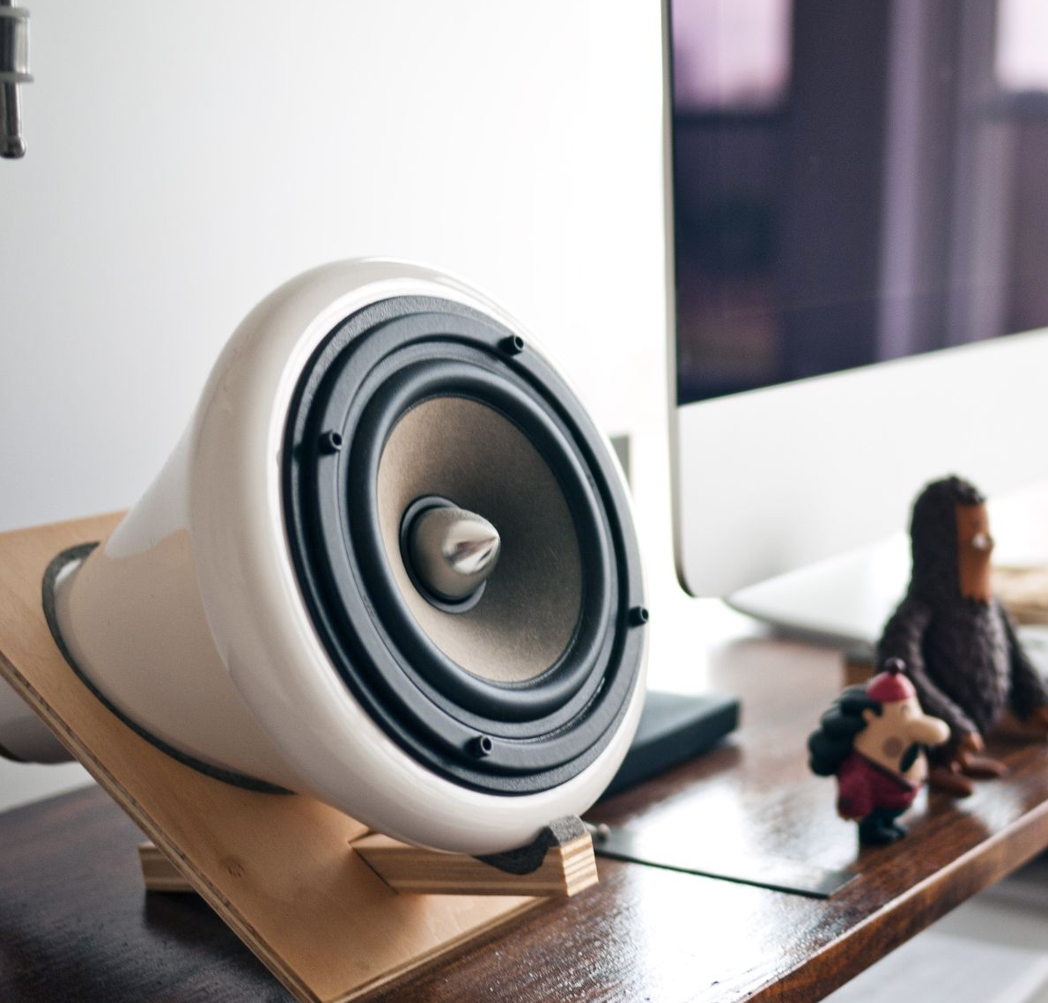

Lesson learned
Changes can happen at any time
As a Software engineer you have to be ready for anything
You should learn Django, well really it is awesome for web development

Slide 17
Honorable mention
Sofia
Mario
Arman
Anjas
The other Vladimir
AND, Alexander
Thank you for your great help and support ...

Slide 18


Questions ?

